Slide 1
Progress Report
Basis Technology
Kratika Agrawal, Vandana Anand, Xinlu He, Min Huang, Soumya Joshi, Jing Yu

Slide 2

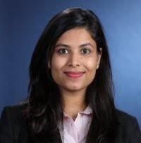




Project Team Introduction
Sponsors & Mentors
Gil Irizarry Kfir Bar
Vice President - Engineering Chief Scientist
gil@basistech.com kfir@basistech.com
Team Members
Vandana Anand vanand@wpi.edu 978-427-5212 | Kratika Agrawal kagrawal@wpi.edu 774-701-9288 | Jing Yu jyu5@wpi.edu 608-886-8578 | Soumya Joshi sjoshi2@wpi.edu 508-615-8354 | Min Huang mhuang3@wpi.edu 774-253-5410 | Xinlu He xhe4@wpi.edu 774-253-8221

Slide 3

Project Goal
Goal: Improve BT’s current entity linking tool Rosette by applying a novel model to increase entity linking performance.
Current Stage: Implement three entity linking models based on research papers.
Notes:
Rosette is a text analytics tool used to extract entities from large amounts of text, specifically nouns such as a person, place, time, etc

Slide 4
Previous weeks’ accomplishments
Latent Relations Model
Completed training the latent model (Colab)
Completed calculating the prior possibility
End to End Model
Working on training the model using AIDA dataset
Transforming the BT dataset
DeepType Model
Divided the work into two approaches
Run Github module on AIDA dataset
Transform AIDA dataset to trainable format and continue training and evaluation

Slide 5
Latent Relations Model

Slide 6
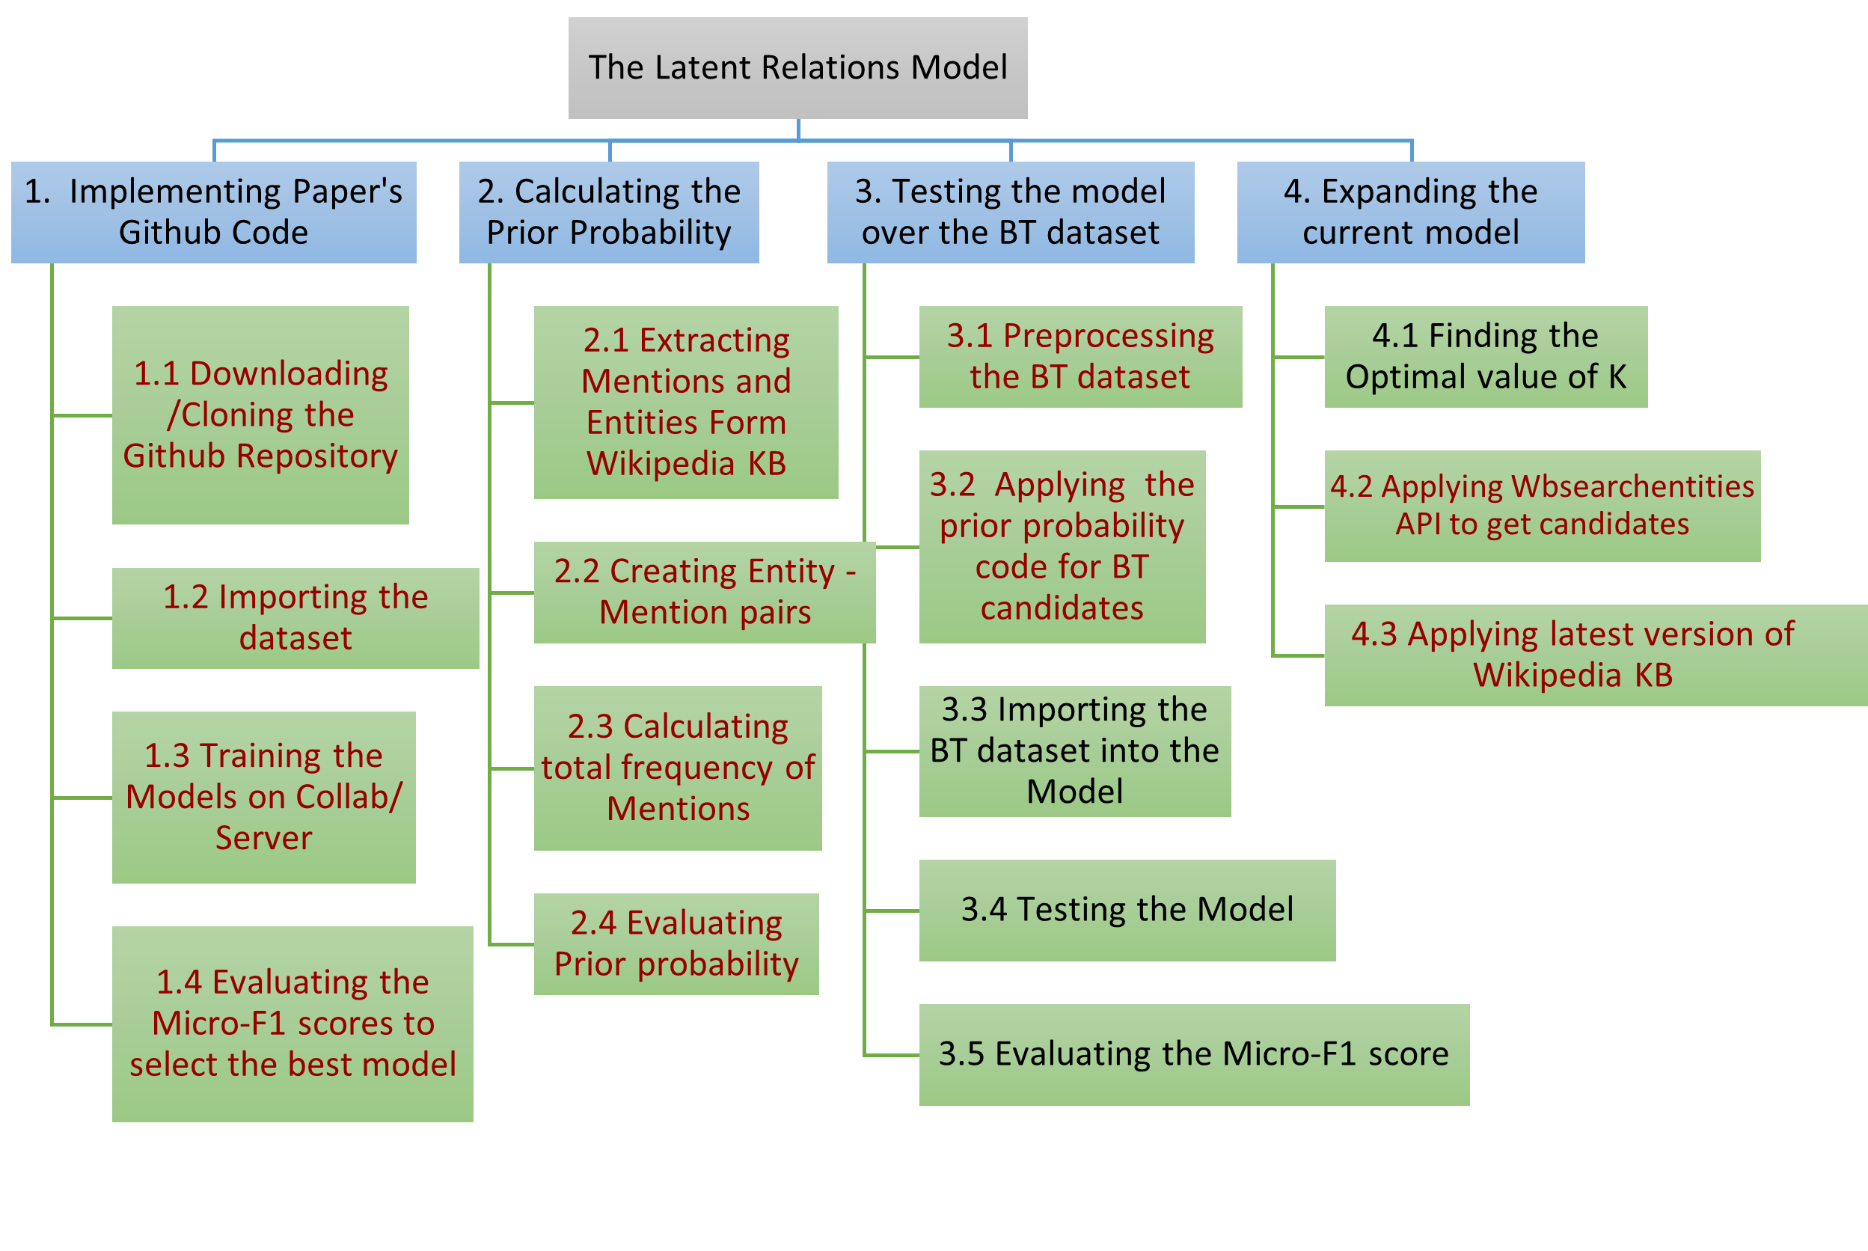
Work Breakdown Structure
Notes:
Prior probability is to be calculated as an input to the nn model, We will need to calculate the prior probability for the company’s dataset, K(no of relations)

Slide 7
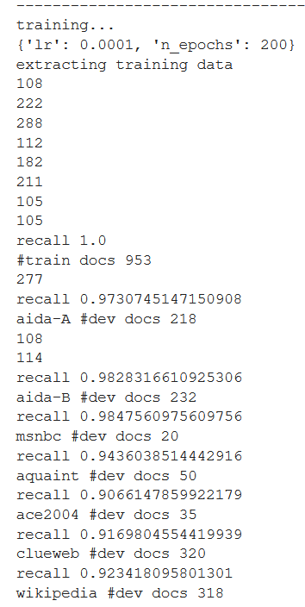
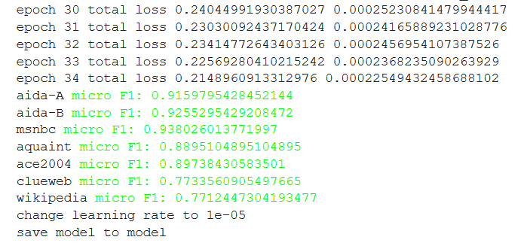
Training Results
Training results of the latent model

Slide 8
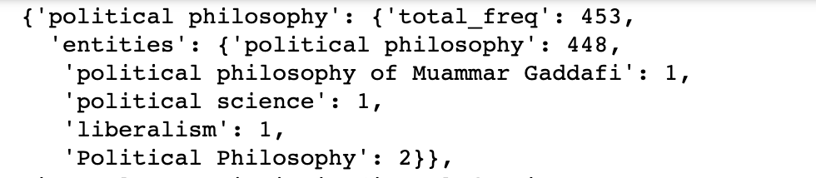
Prior Probabilities
Calculating prior probability - based on Wikipedia2014textfile
[mention,entity] Frequency: The times that the mention linked to the entity in Wikipedia KB
P(e|m) = [mention,entity] Frequency / All the [mention, entity] pairs Frequency for each mention
Format:
data[mention] = {‘total_freq’: counts, ‘entities’:{‘entity1’:counts,’entity2’:counts}}
e.g. data:

Slide 9
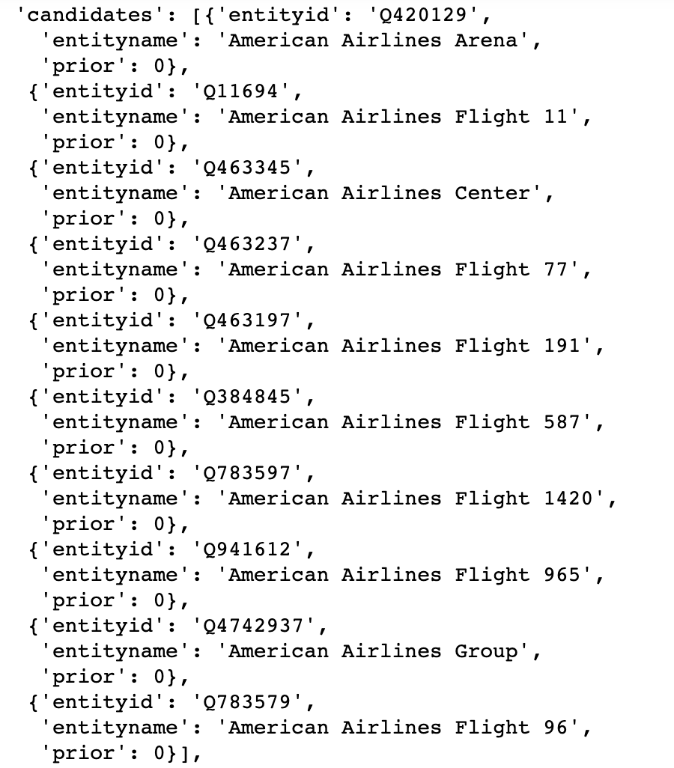
Prior Probabilities
Integrate with BT data
Many zero values for prior probabilities
Mention not existed
[Mention, entity] pair not existed
Reasons:
Frequency calculation is based on wiki2014textfile
1. BT dataset is new
e.g. Mention: Corona
2. Entities selection is based on latest wiki KB(API)
3. Transformed mentions to get 10 candidates
[mention,entity] pair might not exist in wiki KB
Solution for Reason 2 &3:
Select candidates directly from wiki2014textfile
254 (total 452) mentions could not get 10 candidates

Slide 10
Next Steps
Solutions
BT provided an approach to get the latest version of wikipedia KB
Applied wikiextractor to get articles
Applied unquote() to transform URL strings to normal strings
e.g. Séamus O\'Doherty (11 June 1882 - 23 August 1945) was an <a href="Irish republicanism">Irish republican</a>.\n\nSéamus O\'Doherty was born on 11 June 1882 in <a href="Derry">Derry</a>.
Next steps
Calculate frequency based on the new wikipediatextfiles
Try both candidates selection approaches( wiki API & directly extract from wikitextfile)
Generate final BT dataset
Apply the BT dataset to test the model

Slide 11
End2End Model
Notes:
The End to End model includes Mention Detection(MD) and Entity Disambiguation(ED)

Slide 12
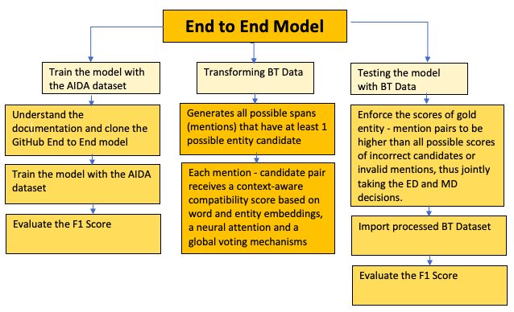
Workflow

Slide 13
End to End Model
In the process of training the End-to-End models with the AIDA dataset
Lot of pre-processing steps, used the data set End2End provided directly
Candidate choosing by using Wiki API
Encountered some challenges with the instructions as they were bit confusing
Executing commands in python and not enough space. Just got access to the server which would help, currently trying to look at documentation and run the model
Large data file sizes to train the model

Slide 14
Next Steps
Next is to use the BT dataset to perform testing
the format of the input data for the entity disambiguition:
format of the input data for entity linking:
Need to transform the BT dataset and process it so it will fit the end to end model

Slide 15
DeepType Model

Slide 16
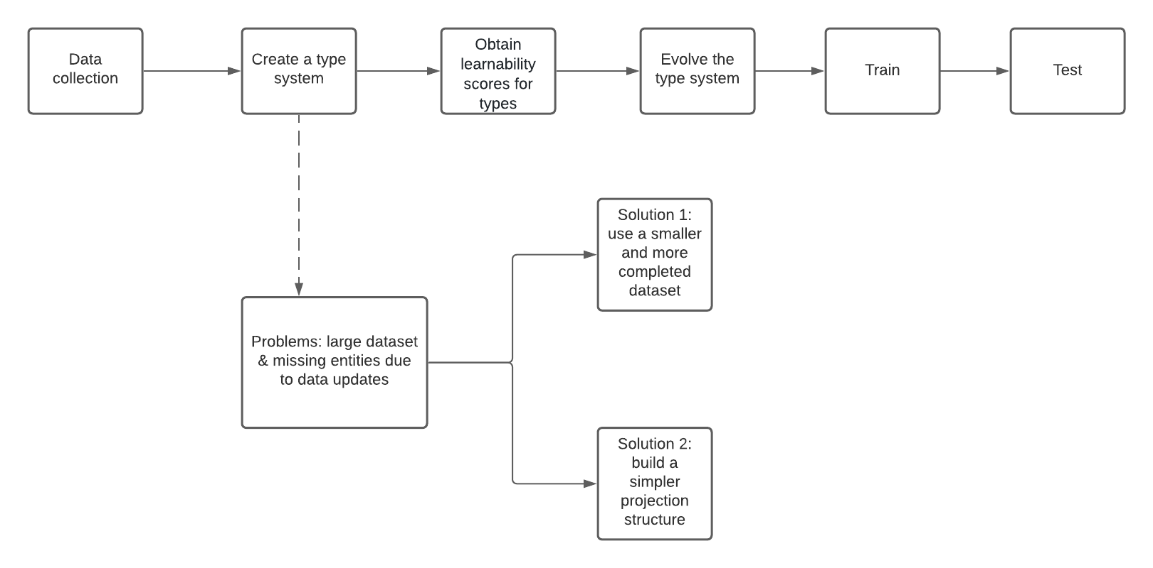
Workflow

Slide 17
Major Issues:
Wikidata Entity dataset is larger than expected: 1.5 TB
Wiki english articles dataset: 75 GB
Data pre-processing fails with error for many missing entities: Difficult to handle all missing entities

Slide 18
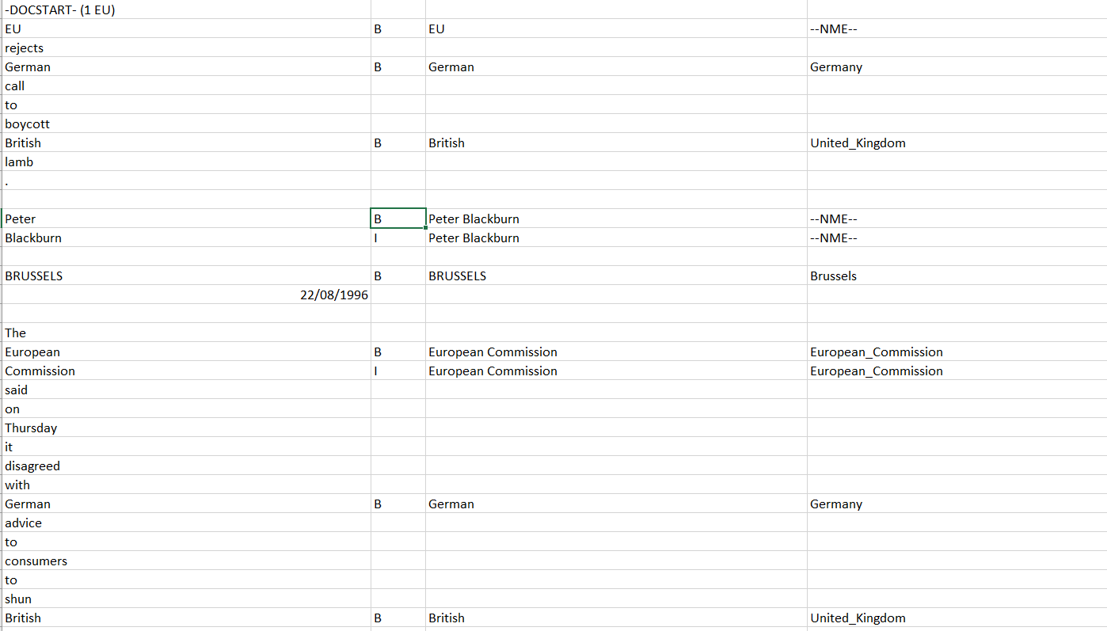
Current Approach:
Converted AIDA data document tokens to text documents:

Slide 19
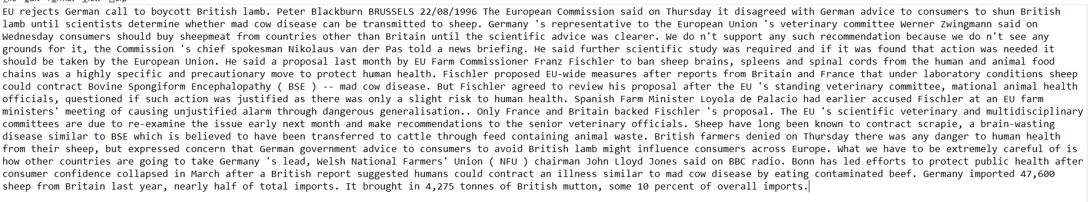
Entity Extraction:
Extracted unique entities using Basis Technology Rosette Entity Extractor:

Slide 20
Approach 1:
Formatting converted documents to wiki-article format supported by deepType github implementation
Extracting wikidata details for each mention using Pywikibot
Refactoring pywikibot response to json format that deepType github implementation support
Plan to train using github code on transformed data and calculate F1 score

Slide 21
Approach 2:
Extracting wikidata details for each mention using Pywikibot
Use entity claim details to create a knowledge graph depicting all entities and relations
Classify various related types to one. Eg: Human, Person, Homo Sapian => is_Human
Build a type system following this approach
Train classifier to evaluate the type system
Use greedy search approach to locate entity on the graph
Evaluate performance (F1 Score)

Slide 22
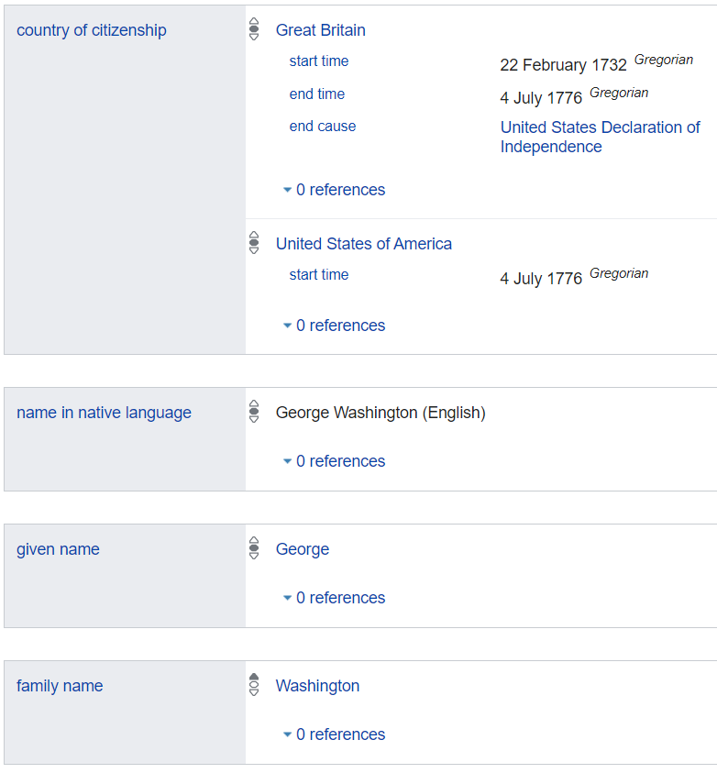
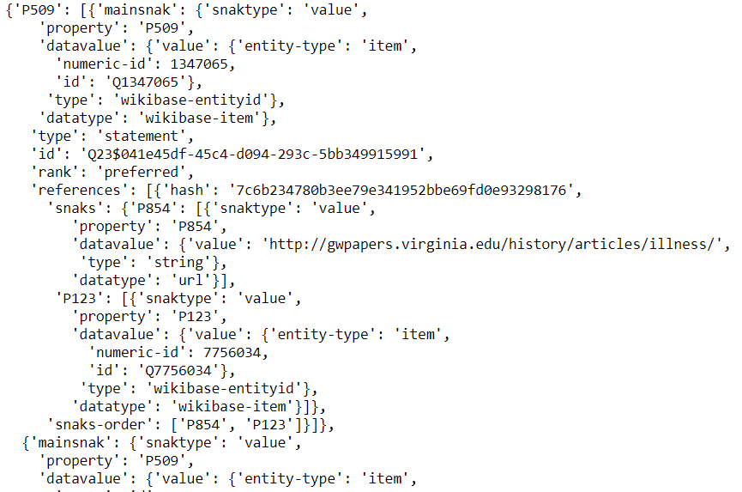
Entity Claims:

Slide 23
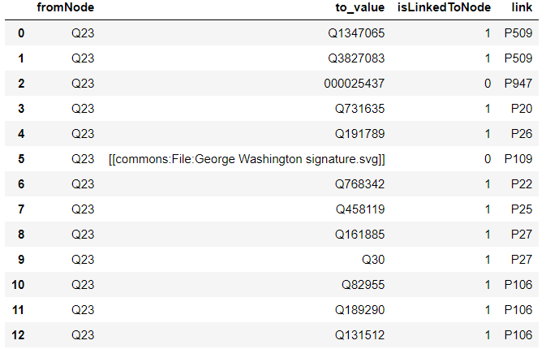
Knowledge Graph:

Slide 24
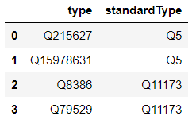
Type Linking:
Converting closely related types to a standard Type:
Person
Human
Homo sapian
Drug
Chemical Compound
Chemical Substance

Slide 25
Difficulties
Calculated entities frequency based on 2014 Wikipedia KB which brings problems when integrating BT data
Large data files and not enough space
Documentation to run models are bit confusing and require other installation packages
Server access issues

Slide 26
Contribution
Training the latent model (Soumya, Min)
Workflow Summary (Soumya)
Calculating the prior probabilities (Min)
End to End Training Model (Vandana, Xinlu)
Workflow Diagram (Vandana)
Converting document tokens to documents (Kratika)
Extracting Unique entities using REX (Kratika)
Extracting Wikidata entities corresponding to Wikipedia Entities (Jing)
Extracting candidate entities (Jing)
DeepType model Github implementation (Jing)
Formatting AIDA data to format used in deepType code
DeepType model Approach 2 implementation (Kratika)

Slide 27
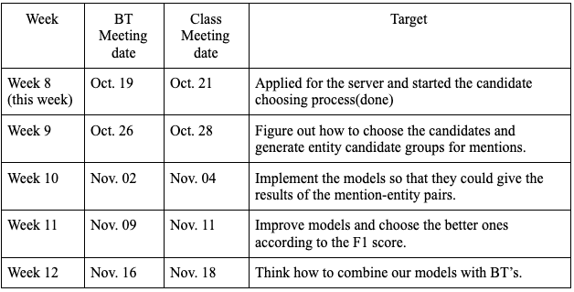
Plans
Implementation Timeline
Notes:
in the upcoming weeks we will implement the final models for the company’s dataset and see if we can get a better micro f1 score

Slide 28
Thank you!
Any Questions?

